Slide 1



Information Communication Technology
(CSC101)
Lecture 1
Instructor: Mariam Fiaz
email: mariamsherwani434@gmail.com

Slide 2


Reference Books:
  Understanding Computers: Today and Tomorrow, Comprehensive – Deborah Morley & Charles S. Parker, Cengage Learning, 2017 (Read Chapters 1 & 4)
  Computer Science Illuminated – Nell Dale & John Lewis, Jones & Bartlett Learning, LLC, 2020 (Read Chapter 1)

Slide 3
Contents:
  Basic Definition of IT, Computer Technology & Communications Technology
  Role of IT in Society
  Computing Models: Turing Model, Von Neumann Model
  Input Devices
  Output Devices
  How Computers Process Data
  Central Processing Unit (CPU)
  Memory
  Bus & Types
  Ports & Interfaces

Slide 4
Information Technology (IT):
Basic Defination
Information Technology (IT) refers to the use of computers, software, networks, and communication systems to collect, process, store, and transmit information. IT combines computing devices with communication technologies to support data handling, information exchange, and decision-making in organizations and society.

Slide 5
IT is not limited to computers alone; it also includes networking infrastructure, software applications, data management systems, and digital communication tools.

Slide 6
Computer Technology and Communication Technology
Computer
Tecchnology
Communication
Tecchnology
Computer technology focuses on hardware and software systems used to process data into meaningful information. It includes input devices, processing units, memory systems, output devices, and the software that controls system operations.
Communication technology deals with the transmission of data and information between devices and users. It includes networks, the Internet, wireless communication systems, and data transmission protocols. Together, computer technology and communication technology form the foundation of modern Information Technology systems.

Slide 7
Role of IT in Society
Information technology plays a vital role in modern society by improving access to education, enhancing healthcare services, supporting business operations, enabling global communication, and promoting social connectivity. Through digital libraries, online education platforms, and affordable computing devices, IT helps reduce the digital divide between different regions of the world.

Slide 8
Computing Models
“Computing models describe how computers process data”
1. Turing Model
The Turing Model explains computation in terms of a theoretical machine that follows a defined set of rules to manipulate symbols on a tape. It establishes the limits of what problems can be solved using computation.
Proposed by Alan Turing, this model:
  Represents computation using a theoretical machine
  Consists of:
    An infinite tape (memory)
    A read/write head
    A set of rules

Slide 9
2. Von Neumann Model
The Von Neumann architecture is the basis of most modern computers.
Main components:
  Input unit
  Output unit
  Memory unit
  Control Unit
  Arithmetic & Logic Unit (ALU)
Key concept:
  Stored-program concept (data and instructions stored in same memory)

Slide 10
Input Devices
Input devices are used to enter data and instructions into a computer system. According to the syllabus, the main categories of input devices include:
  Keyboard – Used to input text, numbers, and commands.
  Pointing Devices – Such as mouse and trackpad, used to control on-screen movement and selection.
  Touch Devices – Touchscreens that allow direct interaction with the display.

Slide 11
Input Devices
  Game Controllers – Joysticks and gamepads used mainly for gaming and simulations.
  Optical Input Devices – Scanners and barcode readers that capture printed or visual data.
  Audio-Visual Devices – Microphones and cameras used to input sound and images.

Slide 12
Output Devices
Output devices present processed information to users in an understandable form. As stated in the syllabus, the main output devices include:
  Monitors – Display visual output such as text, images, and videos.
  Audio Output Devices – Speakers and headphones used to produce sound output.
  Printers – Produce hard copies of text and graphics. Plotters – Used for printing large-scale graphics such as maps and engineering drawings.

Slide 13
How Computers Process Data
Computers process data using a sequence of operations known as the machine cycle. The machine cycle consists of fetching instructions, decoding them, executing the instructions, and storing the results. These operations are synchronized by the system clock.
Computers follow the Input–Process–Output (IPO) cycle:
  Input data is entered
  Processing is performed by CPU
  Output information is produced
  Results may be stored for future use

Slide 14
Central Processing Unit
The Central Processing Unit is the main component responsible for processing instructions.
1. Control Unit (CU)
The Control Unit directs all operations of the computer system, manages data flow, and interprets program instructions.
  Directs all operations
  Fetches and decodes instructions
  Controls data flow between components

Slide 15
2. Arithmetic and Logic Unit (ALU)
The Arithmetic and Logic Unit performs arithmetic calculations and logical comparisons.
  Performs arithmetic operations
  Executes logical comparisons2. Arithmetic and Logic Unit (ALU)
3. System Clock and Machine Cycle
  System clock controls timing
  Machine cycle includes:
  Fetch
  Decode
  Execute
  Store

Slide 16
Memory
Volatile Memory
Non-Volatile Memory
Registers and Cache Memory
Volatile memory stores data temporarily and loses its contents when power is turned off. Random Access Memory (RAM) is an example of volatile memory
Non-volatile memory retains data even when power is turned off. Examples include Read-Only Memory (ROM) and flash memory.
Registers are the fastest type of memory located inside the CPU.
Cache memory is a high-speed memory that improves processing speed by storing frequently used data.
Flash Memory
  Non-volatile
  Used in USB drives and memory cards

Slide 17
Bus and Types
A bus is a communication pathway used to transfer data, instructions, and control signals between computer components. Types of buses include data bus, address bus, and control bus.
Types of bus:
  Data bus (Sends data between the processor, memory, and input-output devices).
  Address bus (Transmits the address between the processor and memory).
  Control bus (Transmits timing, status signals and commands between processor, memory and I/O devices).

Slide 18
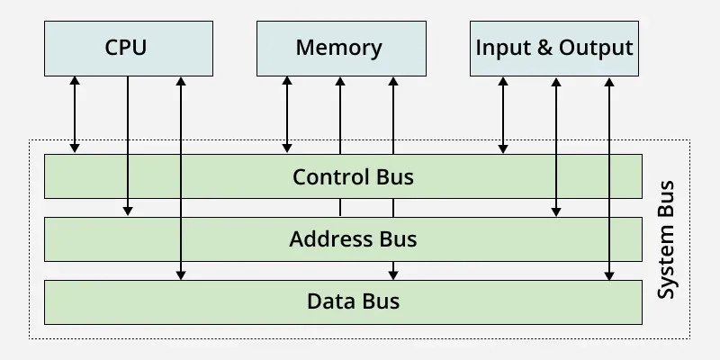
Diagram

Slide 19
Ports
Ports are interfaces used to connect external devices to a computer system, such as USB ports, HDMI ports, and network ports.
Examples:
  USB
  HDMI
  Ethernet

Slide 20
Summary of
Lecture 1
In this lecture, we introduced Information Technology, its role in society, and basic computing models. We covered how computers process data, CPU and memory functions, input and output devices, and the role of buses and ports in system communication.

